Slide 1
ElasticSearch Introduction
"You know, for Search"

Slide 2
Agenda
What is ElasticSearch ?
Using ElasticSearch - simple examples
ElasticSearch .NET and NEST
Under the covers
Index configuration
Text analyzers
Kibana
If time allows:
Geosearch, percolator, re-indexing strategy

Slide 3
ElasticSearch
"an end-to-end search and analytics platform.
infinitely versatile."

Slide 4
The ELK stack
ElasticSearch
Elasticsearch is a flexible and powerful open source, distributed, real-time search and analytics engine.
Logstash
Logstash helps you take logs and other time based event data from any system and store it in a single place for additional transformation and processing.
Kibana
Kibana is Elasticsearch’s data visualization engine, allowing you to natively interact with all your data in Elasticsearch via custom dashboards.

Slide 5
ElasticSearch
Open source, founded in 2010
Java (cross platform)
JSON over HTTP
Builds on Apache Lucene

Slide 6
Lucene vs Elastic
Lucene
ElasticSearch
Is a Java class library for search
Is not distributed
Integration using Java code
Filesystem based
Manage scaling manually
"very complicated"
Builds on top of Lucene
Is built for distribution
Uniform RESTful HTTP API
High availability, durable
Scales out
Easy to use

Slide 7
What is a search engine ?

Slide 8
Getting started
Download ElasticSearch
Change the default cluster name in the .config file
Run it (you must have Java installed)
Or
Use a pre-built Vagrant virtual machine, there are several available
(or Docker)

Slide 9
How to use ElasticSearch
ElasticSearch uses a REST interface over HTTP with JSON data
HTTP methods are mapped as you would expect
You can PUT something to a URL
GET the same URL to get it back
DELETE to delete it.
HEAD to check existence.
Examples (Sense)
Index a document
Perform a search

Slide 10
How to use ElasticSearch
From .NET
ElasticSearch .NET
Low-level – exposes methods corresponding to the REST endpoints
NEST
High-level, opinionated

Slide 11
Queries vs filters
Queries generally are for full-text searches that should affect document ranking
Filters are for yes/no matches
Filters can be cached by ElasticSearch and should be preferred for making exact matches
Such as selecting the brand and model
Or filtering a price range

Slide 12
Aggregations
Some times called facetting
Can be used to analyze the data in ElasticSearch
Sum, min, max, std.dev and many more and advanced operators
Or generating search navigators
Aggregations can run pre- or post filters

Slide 13
Under the covers – cluster and nodes
When we code against Elastic, we connect to a cluster
A cluster consists of one or more nodes
A node is typically one machine with ElasticSearch installed
But, for development purposes:
A cluster can be one node
A cluster can be on one machine with many nodes (instances of Elastic)

Slide 14
Clusters & nodes
Allows us to scale out by adding more nodes
Provides availability and resiliency against failure.
In a correctly configured Elastic cluster:
A number of nodes can fail (hw/network) without data loss
- And without affecting availability

Slide 15
Clusters & nodes
A cluster is a set of nodes (instances of ElasticSearch) sharing the same cluster.name, set in the config
By default, the cluster will automatically discover new nodes and start using them.
This is done using multicast communication on the network, so spinning up a new node with an existing cluster.name will join it to the cluster.

Slide 16
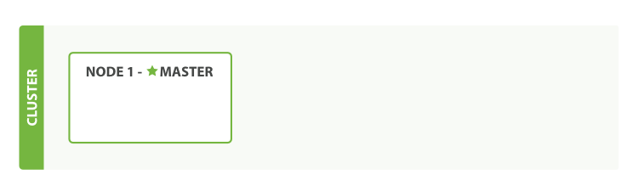
Clusters and nodes
The cluster elects a master node, taking care of master-level operations
Any node can be the master

Slide 17
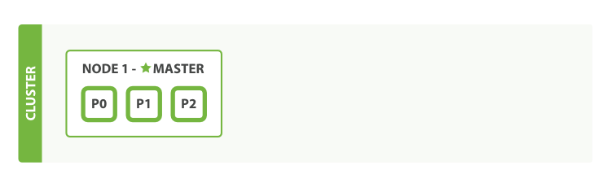
Clusters and nodes
A node has a number of indexes, each consisting of a number of Shards.

Slide 18
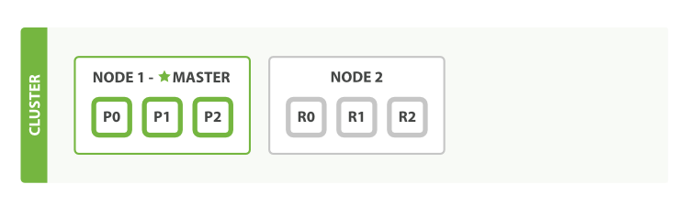
Clusters and nodes
Adding node(s) immediately cause ElasticSearch to start replicating shards to the new node

Slide 19
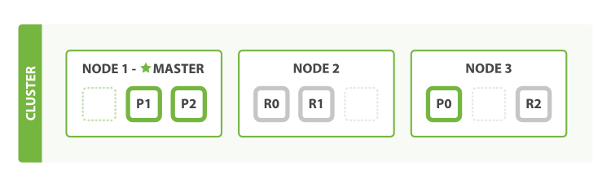
Scaling out
Writes happen to the primary node first, then on the replicas
If we lose a node with a primary shard, one of the replicas will be promoted to primary
GET by Id only needs to touch the node the document is stored on
Searches happen on all nodes in parallel
Both replicas and primaries can serve search requests

Slide 20
Cluster health
GET _cluster/health
Green – all indexes are up with the number of replicas active as assigned when creating the index
Yellow – all indexes are up, but the required number of replicas is not
Red – shards missing
This can also be queried on index or shard level

Slide 21
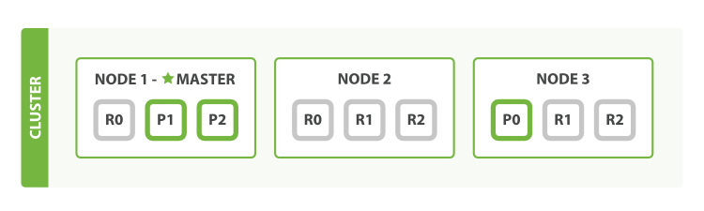
Scaling some more
Number of replicas can be increased per-index
Allows us to distribute load on demand when adding nodes

Slide 22
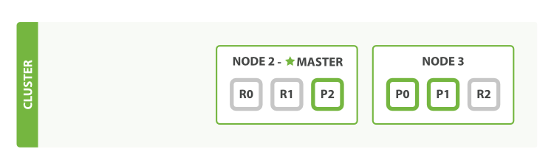
Losing a node
If we lose a node, replicas can be promoted to primaries
Replicas never live on the same node as their primary
Or, we never have 2 copies of the same data on the same node
If we want 2 replicas we need at least 3 nodes

Slide 23
Types & Mappings
The mapping is part of the index configuration, and it tells ElasticSearch how to store each property for each type.
If you just write to an index without defining the mapping, ElasticSearch will create a mapping for you.
ElasticSearch tries to do the right thing …
… and that works great for demos …

Slide 24
Types and mapping
ElasticSearch deduces the mapping when it first encounters a type
Which may not be what you want

Slide 25
Types & mappings
ElasticSearch supports the following simple types:
String: string
Whole number: byte, short, integer, long
Floating-point: float, double
Boolean: boolean
Date: date

Slide 26
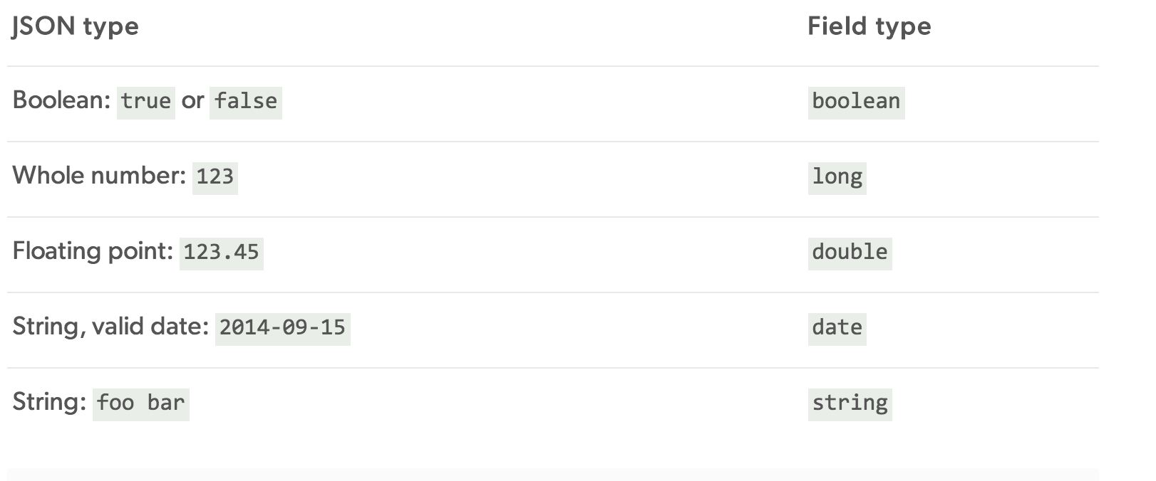
Dynamically deduced types

Slide 27
Arrays
All fields can be an array (ie. have none, one, or many values)
All elements in an array must have the same type

Slide 28
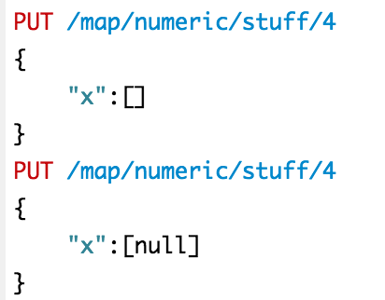
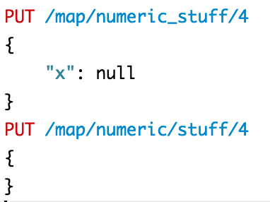
Nulls
Null is stored as the absence of a value
No difference between omitting the field or setting it to null
These are functionally equivalent:
But notice that _source is stored as the exact document that was input. It’s only the search index that collapses nulls.

Slide 29
Strings & Exact values
Exact values are … exact values
One way to interpret
Easy to match on
Numbers, bools, dates are exact values
Strings can be exact values
Or analyzed text for ‘full text search’

Slide 30
Exact matching vs full text search
Exact matching
Is boolean – it either matches or it does not
Full text search
Does not need to match exactly the text in the query
Includes a relevancy score – how well does the document match the query ?
Searches in tokens instead of considering a field to be one value

Slide 31
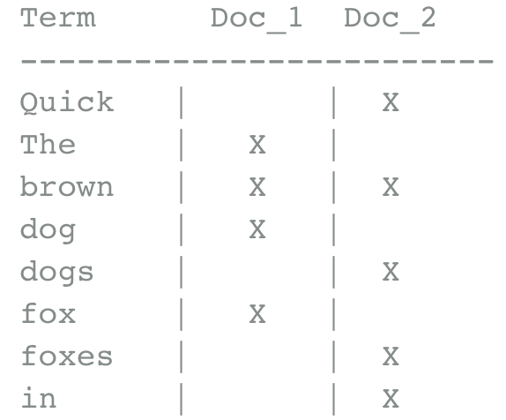
How does full text search work ?
Convert the input string into tokens and put them into an inverted index.
The inverted index is essentially a sorted list of unique tokens,
In which we record which documents contain each term

Slide 32
The inverted index
Searching for “quick brown”
Term Doc_1 Doc_2
-------------------------
Quick | | X
The | X |
brown | X | X
dog | X |
dogs | | X
fox | X |
foxes | | X
in | | X
jumped | X |
lazy | X | X
leap | | X
over | X | X
quick | X |
summer | | X
the | X |
------------------------
Term Doc_1 Doc_2
-------------------------
brown | X | X
quick | X |
------------------------
Total | 2 | 1

Slide 33
Normalizing the index
Some words are considered equal – synonyms
Disregard casing
Throw away punctuation
Reduce words to their root words
Fox and foxes -> Same word
Dog and dogs -> Same word

Slide 34
Normalizing the index
Term Doc_1 Doc_2
-------------------------
Quick | | X
The | X |
brown | X | X
dog | X |
dogs | | X
fox | X |
foxes | | X
in | | X
jumped | X |
lazy | X | X
leap | | X
over | X | X
quick | X |
summer | | X
the | X |
------------------------
Term Doc_1 Doc_2
-------------------------
brown | X | X
dog | X | X
fox | X | X
in | | X
jump | X | X
lazy | X | X
over | X | X
quick | X | X
summer | | X
the | X | X
------------------------

Slide 35
The query must be normalized as well
The query must be normalized in the same way as the indexed fields
Otherwise we won’t be able to match correctly

Slide 36
Analysis
The process of tokenization and normalization is called analysis
This is highly configurable in ElasticSearch and needs to be tuned for the application and content
ElasticSearch ships with a number of analyzers, and
More can be downloaded (often for $$$)
you can write your own (in Java)

Slide 37
Configuring analysis
A string field is analyzed by default
If you want to use a string field for exact matching, you must set it to be notAnalyzed
This can be configured per mapping
Notes:
Go to demo here

Slide 38
Analyzers
Analyzers can be
Character filters
Tokenizers
Token filters
Analyzers can be combined as a chain
The analyzer for a field can be set in the mapping
Analyzer API
Handy for testing out analuzers without re-running indexing

Slide 39
Built in analyzers
Standard analyzer
Default, best general choice
Simple
Splits terms on non-letters and lowercases the terms
Whitespace
Splits terms on whitespace. Doesn’t lowercase
Language specific
Language specific analysis (stemming, stop words, etc) for specific languages
Many default languages, including danish

Slide 40
Other index-level options
# shards (default = 5)
Index “building block” – more on that later
Cannot be changed later !
# replicas (default = 1)
Can be changed after creating the index
For reliability – as long as we have at least 1 replica, the full data set is available
For load distribution
Each replica lives on one node. Any replica (node) can serve a search request.
If you only have 1 index, but 8 nodes in the cluster, setting # of replicas to less than 7 makes no sense – you would just have idle nodes without data on them.
Notes:
Fact-check “each replica lives on one node”.

Slide 41
Type level options
_source: Whether to store the _source field or not
Default yes, generally a good idea to keep it
_all: Whether to index a _all field consisting of all the fields concatenated
Default yes, enables some “simple search” scenarios where you don’t need to specify field name
_include_in_all (per field)
Whether to include the field in _all, default yes

Slide 42
Dynamic mapping options
Per type, can be
True (default)
When ES encounters a new field in a type, automatically create it in the index
False
When ES encounters a new field in a type, silently ignore it (!)
Strict
Throw an exception if an unknown field is encountered
This might actually be what you want !

Slide 43
Index management
You can think of the index as the schema of the search engine
Index changes should be scripted at deploy-time (just like database schema changes)
Index changes should be idempotent
Remember to think about order. Can new code work with the old index or only the new one ?

